Slide 1



TIME-DOMAIN ASTRONOMY
Lectures 8: Non Parametric Analysis
Stefano Covino
INAF / Brera Astronomical Observatory

Slide 2
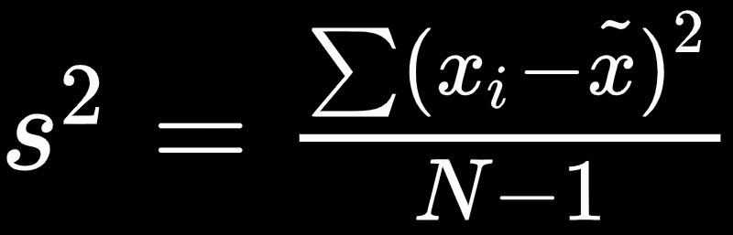
Phase Dispersion Minimization
It is easy to realize that a possible procedure to choose between different periods for a time series could be based on computing which is the one producing the least observational scatter about the mean (derived) light curve.
Let's assume to have a discrete set of N observations represented by an observation time t and a magnitude x.
And be s² the sample variance of x:

Slide 3


Phase Dispersion Minimization
Suppose we have chosen M distinct subsamples, having variances s_{j}² (j=l,M) and containing n_{j} data points. The overall variance for all the samples is then given by:
In order to minimize the variance of the data with respect to the mean light curve be Π a trial period and compute the phases:

Slide 4
Phase Dispersion Minimization
Now let’s pick M samples from x using the criterion that all the members of sample j have similar φ_{j}.
The samples may be chosen in any way that satisfies the criterion. All points need not be picked, or, alternatively, a point can belong to many samples.
The variance of these samples gives a measure of the scatter around the mean light curve defined by the means of the x_{j} in each sample, considered as a function of φ.

Slide 5

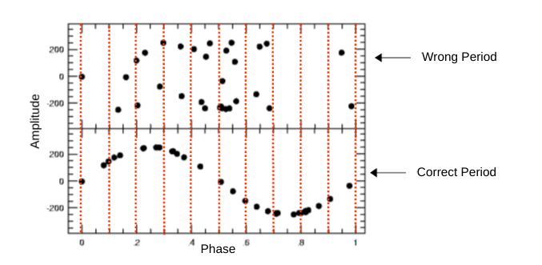
Phase Dispersion Minimization
Finally, let’s define the statistics:
If Π is not the true period, then s² ≃σ², while if Π is the true period Θ will be in a local minimum compared to other tested periods.

Slide 6

Phase Dispersion Minimization
Since this technique seeks to minimize the dispersion of the data at constant phase, it is referred as “phase dispersion minimization” (PDM).
If we assume that our data are normally distributed it can be shown that Θ follow a F distribution with
and N-1 degrees of freedom (since indeed Θ=s²/σ²).

Slide 7
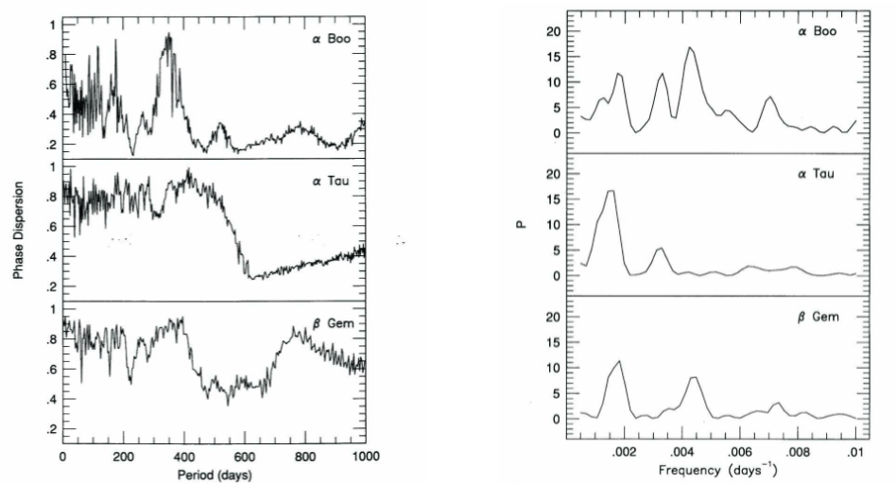
PDM vs Lomb-Scargle
PDM Lomb-Scargle

Slide 8
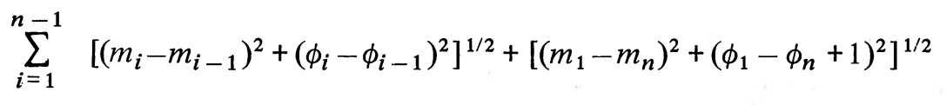
String Length Method
In this method the quantity to be minimized is the sum of the lengths of line segments joining successive points (m_{i}, φ_{i}) in a phase diagram.
The period is chosen to minimize the following quantity, with n the number of observations:
Given that m_{i} and φ_{i} have different units one has to properly scale m_{i}.

Slide 9
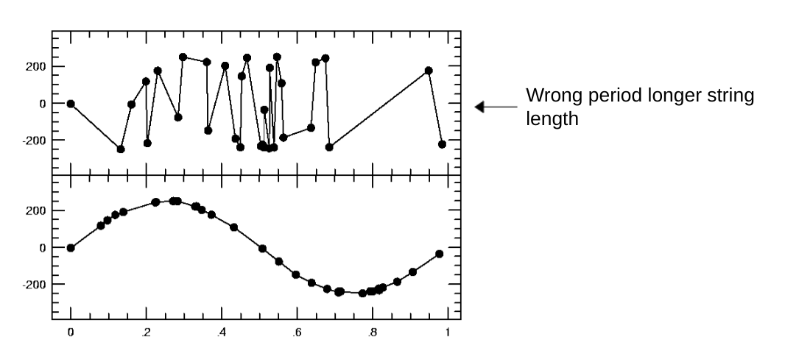
String Length Method
In its essence the algorithm is straightforward:

Slide 10
A rich zoo...
People developed several methods to cope with the characteristics of light curves in astronomy (irregular sampling, etc.).
The most widely used are the Lomb-Scargle (LS) periodogram, epoch folding, analysis of variance (AoV), string length (SL) methods, and the discrete or slotted autocorrelation.
For the LS and AoV periodograms statistical confidence measures have been developed to assess periodicity detection besides estimating the period.

Slide 11
Lomb-Scargle
As we know already, the LS periodogram is an extension of the conventional periodogram for unevenly sampled time series.
A sample power spectrum is obtained by fitting a trigonometric model in a least squares sense over the available randomly sampled data points.
The maximum of the LS power spectrum corresponds to the angular frequency whose model best fits the time series.

Slide 12
Epoch Folding
In epoch folding a trial period, P, is used to obtain a phase diagram of the light curve.
The trial period is found by an ad-hoc method, or simply corresponds to a sweep among a range of values.
This transformation is equivalent to dividing the light curve in segments of length P and then plotting the segments one on top of another, hence folding the light curve.
If the true period is used to fold the light curve, the periodic shape will be clearly seen in the phase diagram.
If a wrong period is used instead, the phase diagram won’t show a clear structure and it will look like noise.

Slide 13
Analysis of Variance and String Length
In AoV the folded light curve is binned and the ratio of the within-bins variance and the between-bins variance is computed.
If the light curve is folded using its true period, the AoV statistic is expected to reach a minimum value.
In SL methods, the light curve is folded using a trial period and the sum of distances between consecutive points (string) in the folded curve is computed.
The true period is estimated by minimizing the string length on a range of trial periods.
The true period is expected to yield the most ordered folded curve and hence the minimum total distance between points

Slide 14
Slotted autocorrelation and beyond...
In slotted autocorrelation, time lags are defined as intervals or slots instead of single values. The slotted autocorrelation function at a certain time lag is computed by averaging the cross product between samples whose time differences fall in the given slot.
All these methods are essentially based on second order statistic analysis.
Information theoretic based criteria extract information from the probability density function.
The slotting technique was extended to the information theoretic concept of correntropy. However, the slotted technique has the drawback that is highly dependant on the slot size.

Slide 15
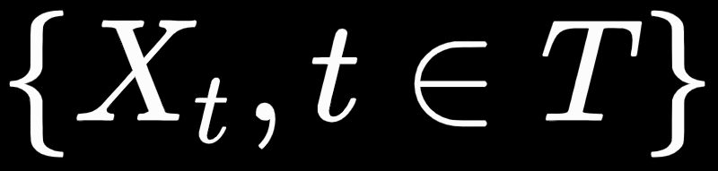

Generalized Correlation Function
The generalized correlation function (GCF) is also known as correntropy. The GCF measures similarities between feature vectors separated by a certain time delay in input space.
The similarities are measured in terms of inner products in a high-dimensional kernel space.
For a random process with T being an index set, the correntropy function is defined as:

Slide 16

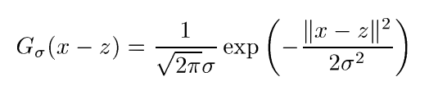
Centered Correntropy
It is also possible to define the centered correntropy:
A kernel can be viewed as a measure of the similarity of the data.
A frequently used kernel is the Gaussian kernel:

Slide 17
Correntropy Kernelized Periodogram
A kernel can be any semi-definite positive function. And it is possible to develop periodic kernels.
This brings to a metric combining the correntropy with a periodic kernel to measure similarity among samples separated by a given period.
This algorithm is known as Correntropy Kernelized Periodogram, and does not require any resampling, slotting or folding scheme as it is computed directly from the available samples.
This idea has strong connection with Gaussian Process analysis, machine learning and information theory,

Slide 18
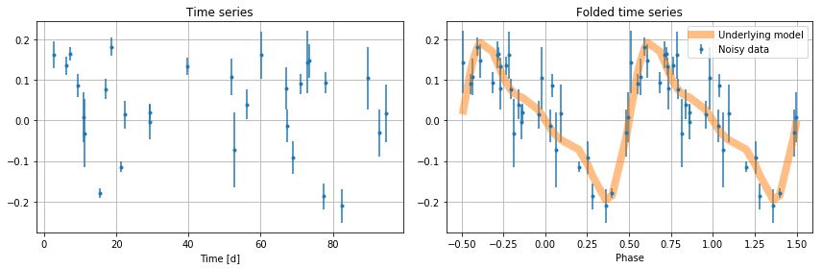
Exercise
Useful notebook:
NonParametricPeriodograms

Slide 19
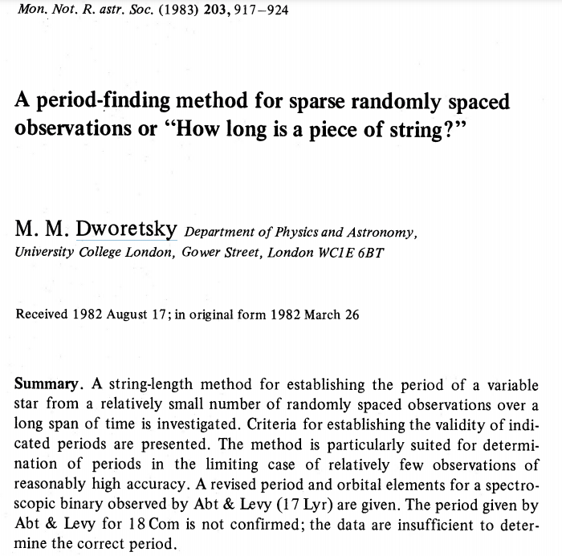
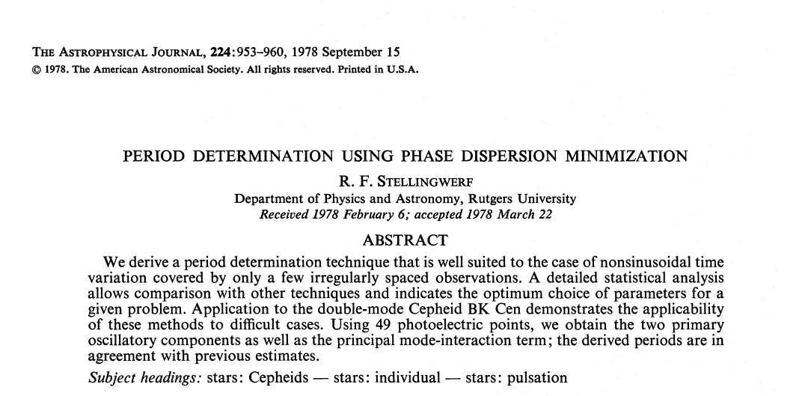


REFERENCES AND DEEPENING
Bob Stellingwerf
Mike Dworetsky

